Slide 1
Password Auditing

Slide 2
A bit of review
/etc/passwd
UIDs
usernames
home directory
shell
/etc/shadow
encryption type
hashed password
password last changed
number of days before password can be changed
number of days required until password change
password change warning threshold

Slide 3

So, remind me
?
?
?
Why are passwords importante?

Slide 4

Well… they are the keys
Typically used to “lock up” your user account and other privileges/data from intruders
Only YOU should know it
It is unique for you
Notes:
Ask them about which letter of CIA this applies to?
Does this pertain to detection or prevention?

Slide 5
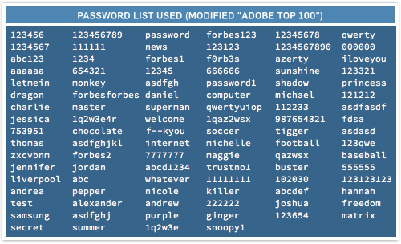
How to make a password effectively
I can use anything as a password right?
Think again
Don’t make them obvious
There are lists, lists, and lists of common passwords out there
*cough* *cough* rockyou *cough* *cough*
Attackers will bruteforce

Slide 6
Mix it up!
Character length
At least 10 is ideal
Vary your characters
Numb3r5
Upper/Lower case letters
Speci@! ch@r@cters
Pro tip: make your passwords memorizable
Make several passwords from a pattern
Pro tip #2: Change your passwords occasionally (30-90 days)
Hackers will have to redo their bruteforce efforts mwahaha
Notes:
Varying characters and lengthening the password makes passwords more difficult to bruteforce
Leads to more combinations that they have to try

Slide 7


Changing user passwords
passwd [user]: begins interactive prompt to change user password
passwd -l [user]: locks user account
passwd -l root: locks root account, we don’t want people to login as root
*Note: run all of the commands mentioned (including those on the previous slide) using sudo because you will probably need privileges

Slide 8
Batch password changes
chpasswd [user]:[password]: can be used to change many passwords quickly
will provide passwords as plaintext
e.g. chpasswd bob:s3cUr3p4ssw0rd
optional to know: more for use in scripts
Makes life easier :)

Slide 9

Now, do you think everyone
Will actually make good passwords?
Notes:
No. Many people are just lazy.
Explain theimportance of having password policies here.

Slide 10
/etc/sudoers
The sudoers file controls how sudo and elevated privileges function on the system.
check for NOPASSWD and !authenticate
remove if it exists
you can refer to a default sudoers file to see if anything is out of place

Slide 11
/etc/sudoers
DO NOT EDIT THIS FILE DIRECTLY
sudo visudo: allows you to edit this file indirectly, checks for syntax errors before saving changes to actual file
prevents you from messing up and destroying sudo privileges

Slide 12
/etc/sudoers
Here is the sudoers syntax:
username hostlist = (userlist) commandlist
e.g. root ALL=(ALL) ALL
root user on all hosts on all users can execute all commands

Slide 13
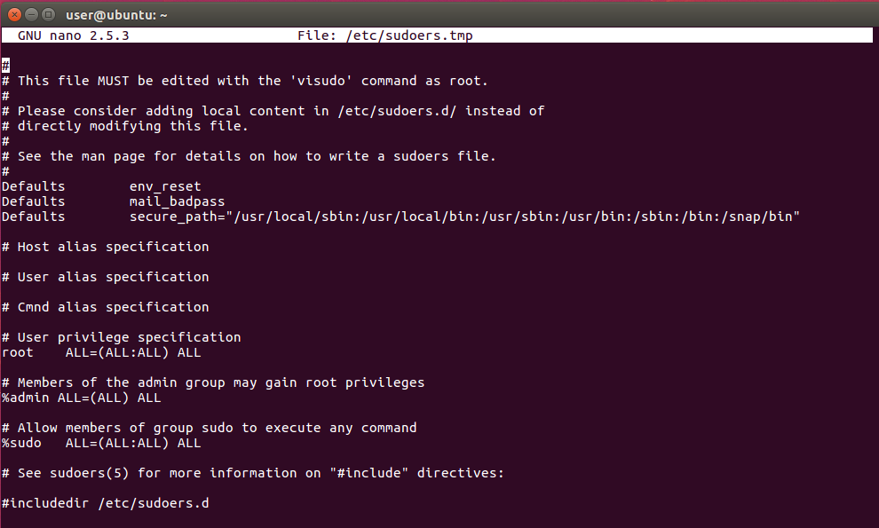
/etc/sudoers

Slide 14
/etc/login.defs
Configuration file for system login restrictions.
PASS_MIN_DAYS 30
user cannot change password for 30 days after changing password
PASS_MAX_DAYS 90
user must change password after 90 days
PASS_WARN_AGE 7
warns user to change threshold 7 days before

Slide 15
chage
Changes user password expiry settings.
chage -M [days] [user]: sets maximum password age for user
chage -m [days] [user]: sets minimum password age for user
chage -W [days] [user]: sets warning threshold for user

Slide 16
PAM
PAM (Pluggable Authentication Module) controls password authentication for many applications.
all configurations are in /etc/pam.d/
sudo apt install libpam-cracklib: installs a PAM module to make sure our passwords are secured

Slide 17
common-password
The common-password module controls how passwords are set, managed, and restricted.
Located at /etc/pam.d/common-password

Slide 18
common-password
password requisite pam_cracklib.so retry=3 minlen=8 difok=3 reject_username minclass=3 maxrepeat=2 dcredit=-1 ucredit=-1 lcredit=-1 ocredit=-1 gecoscheck enforce_for_root
retry=3: allow for three password attempts
minlen=8: minimum password length of 8
difok=3: at least 3 characters must be different from previous password
reject_username: prevent password from being same as username
minclass=3: at least 3 types of characters needed
maxrepeat=2: at most 2 repeated characters
dcredit=-1: 1 digit required
ucredit=-1: 1 uppercase required
lcredit=-1: 1 lowercase required
ocredit=-1: 1 other character required (like a symbol)
*negative=required, positive=recommended for the different credits
gecoscheck: prevent extra fields (e.g. full name, address) from being used as password
enforce_for_root: apply same restrictions to root password

Slide 19
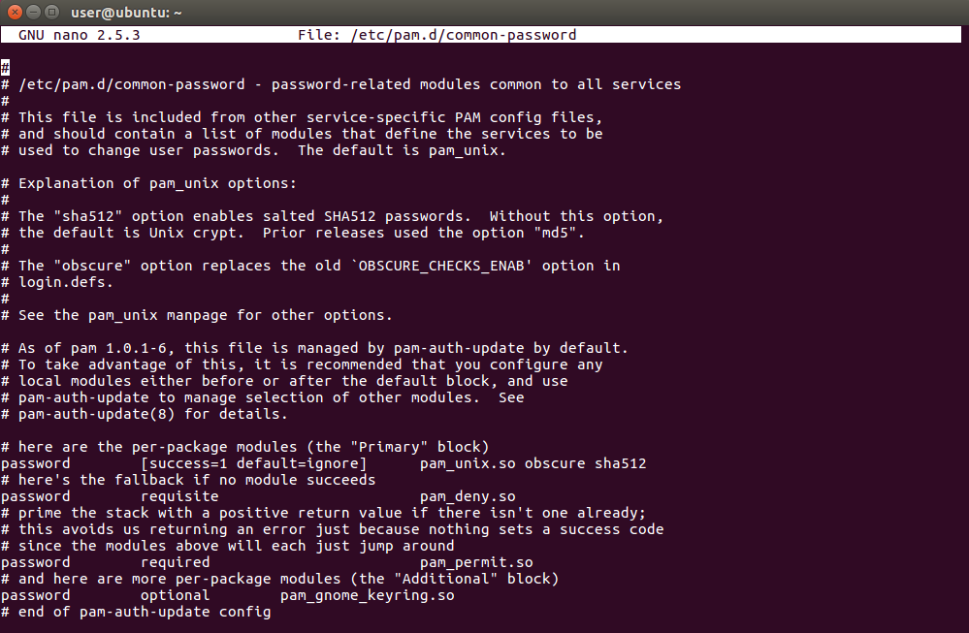
common-password

Slide 20
common-auth
The common-auth module controls how authentication is handled.
Located at /etc/pam.d/common-auth

Slide 21
common-auth
auth optional pam_tally.so deny=5 unlock_time=900 onerr=fail audit even_deny_root_account silent
deny=5: deny user after 5 login attempts
unlock_time=900: locks user out for 900 seconds if all login attempts are used up
onerr=fail: return a fail code if an error happens
audit: logs user if login attempts exceeded
even_deny_root_account: rules apply to root, locks root out if attempts exceeded
silent: don’t print extra information

Slide 22
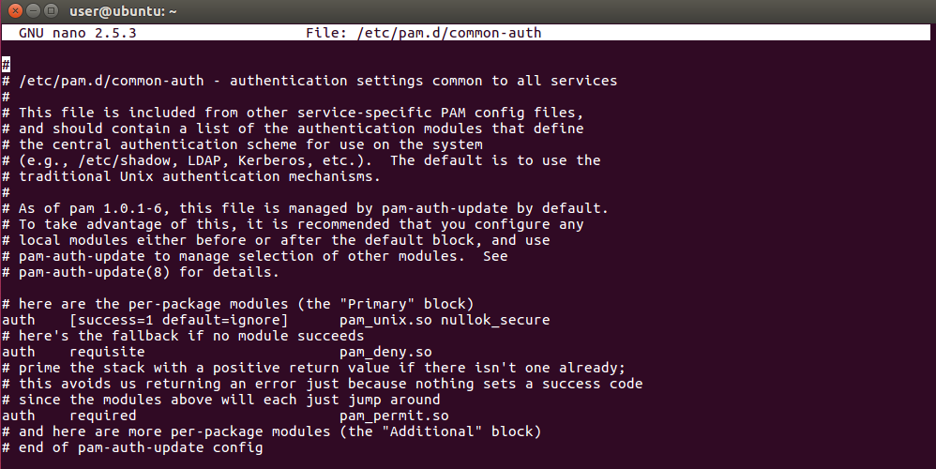
common-auth

